Slide 1
Transportable Rotorcraft Electronic Control System
Emily Bates, Vinh Bui & Yunqing Jia

Slide 2
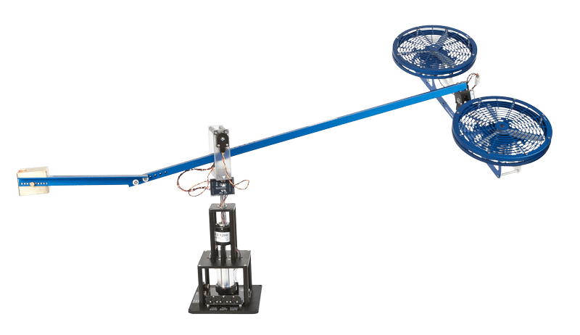
RATIONALE
Provide a complete understanding of a basic control system
Disadvantage of the Quanser
Very expensive (Up to $10)
Bulky and limited quantity
Complex in theory and Software
This project is made for:
Introduce students to various types of control
Experience with Arduino and basic electromechanical system
Transparency of the controller

Slide 3
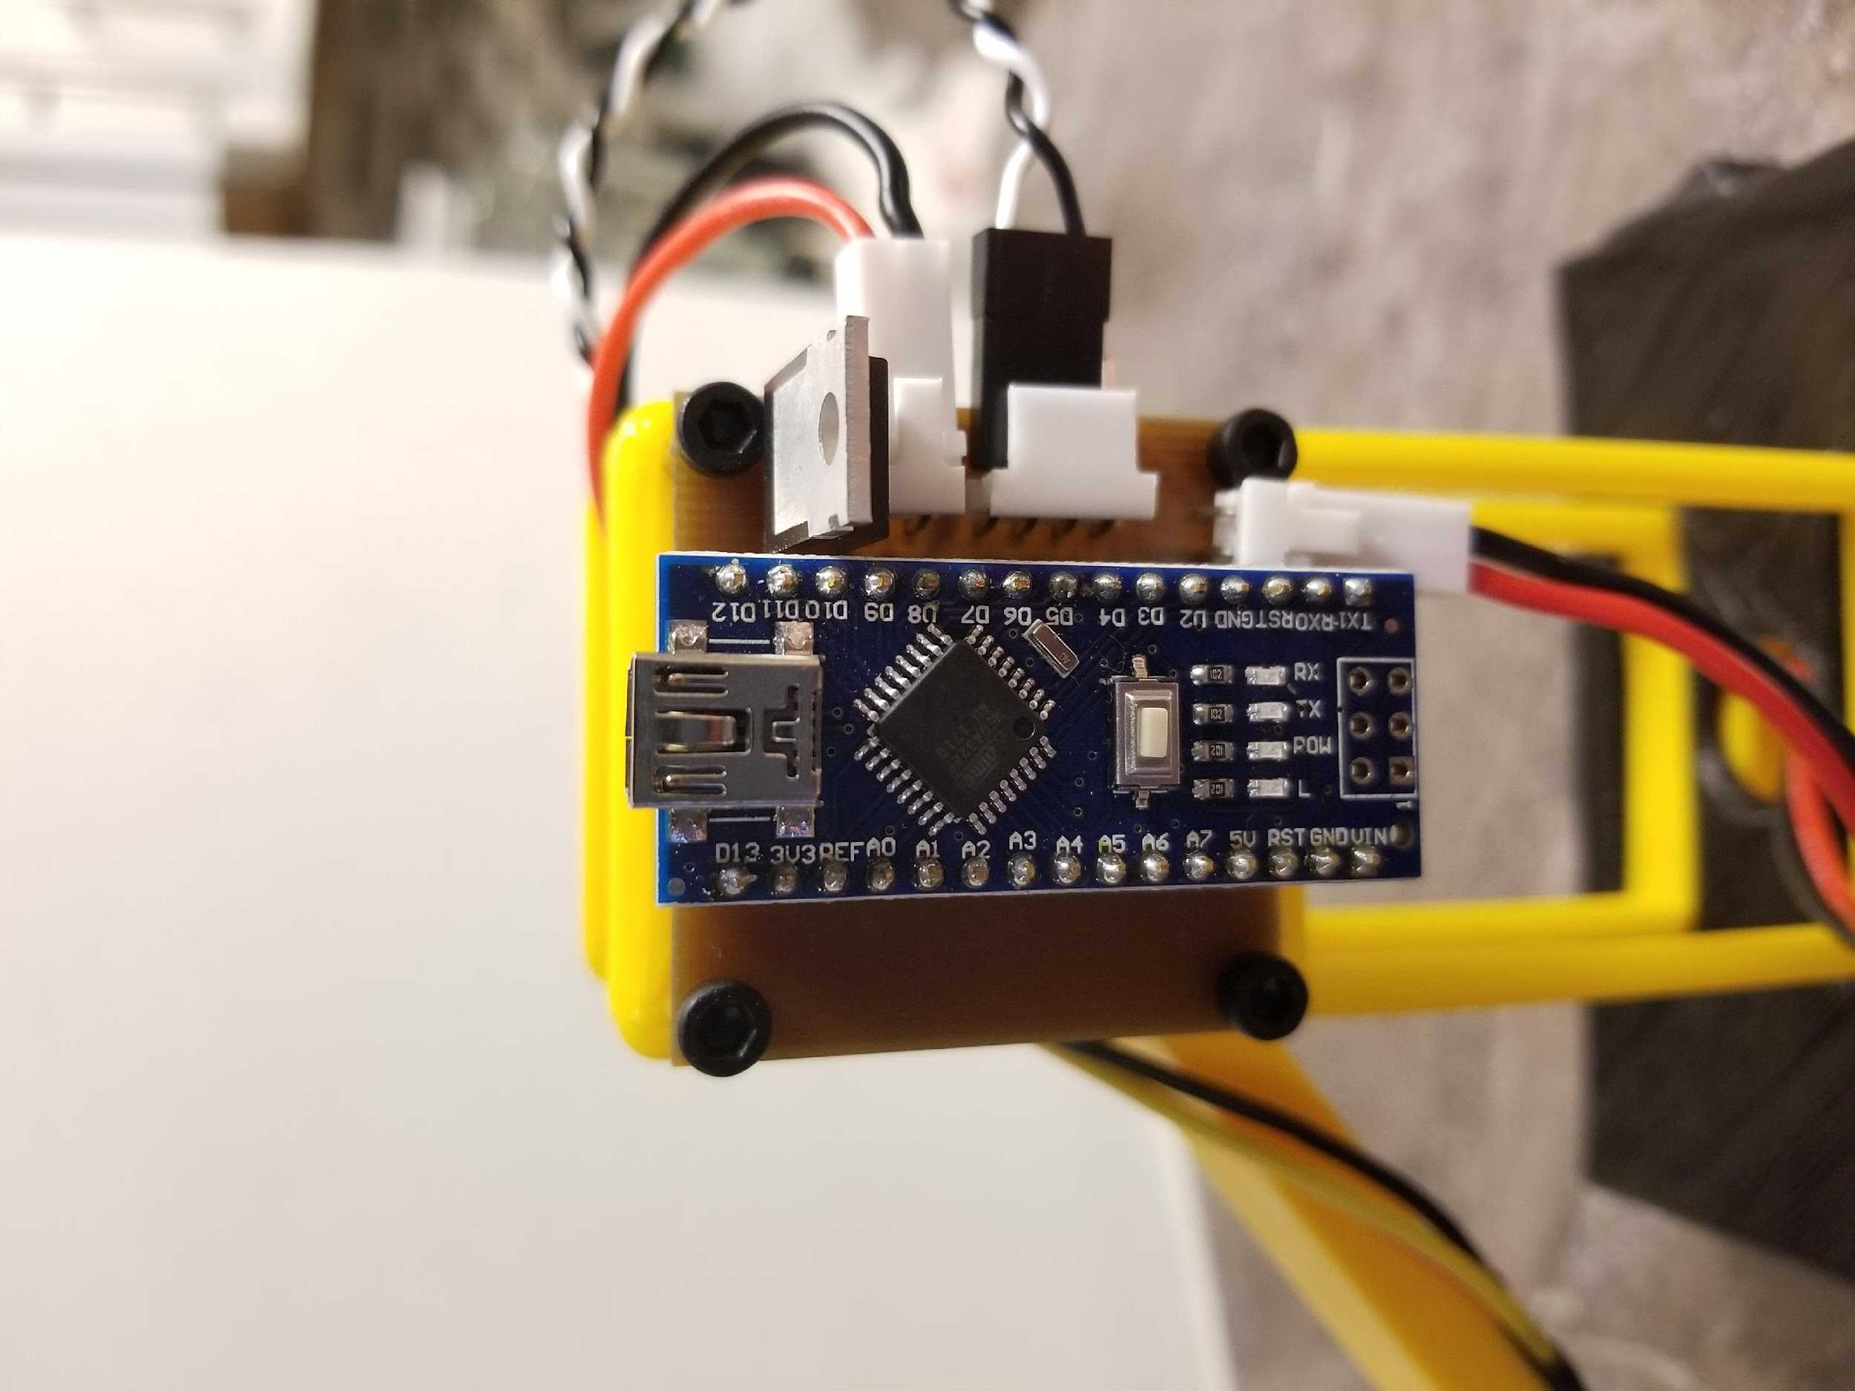
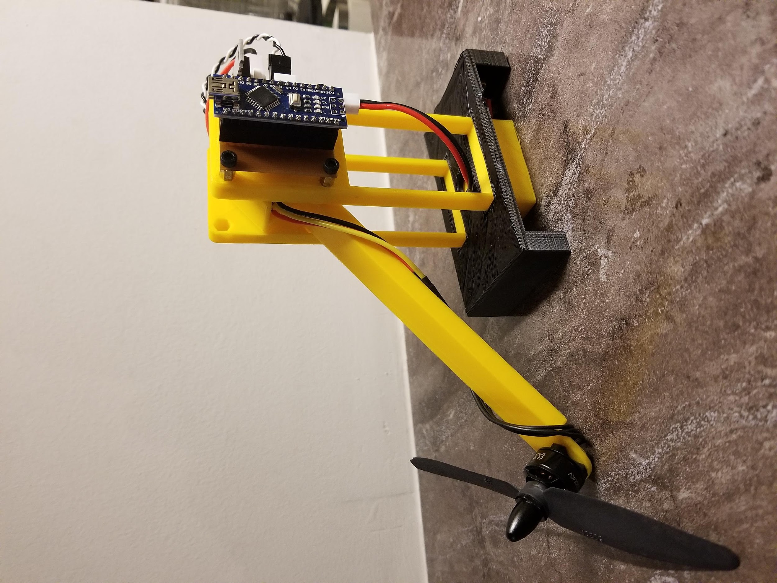
Introducing the “Transportable Rotorcraft Electronic Control System” (T-RECS)
A simple, compact and affordable personal system
Could be used as a final project

Slide 4
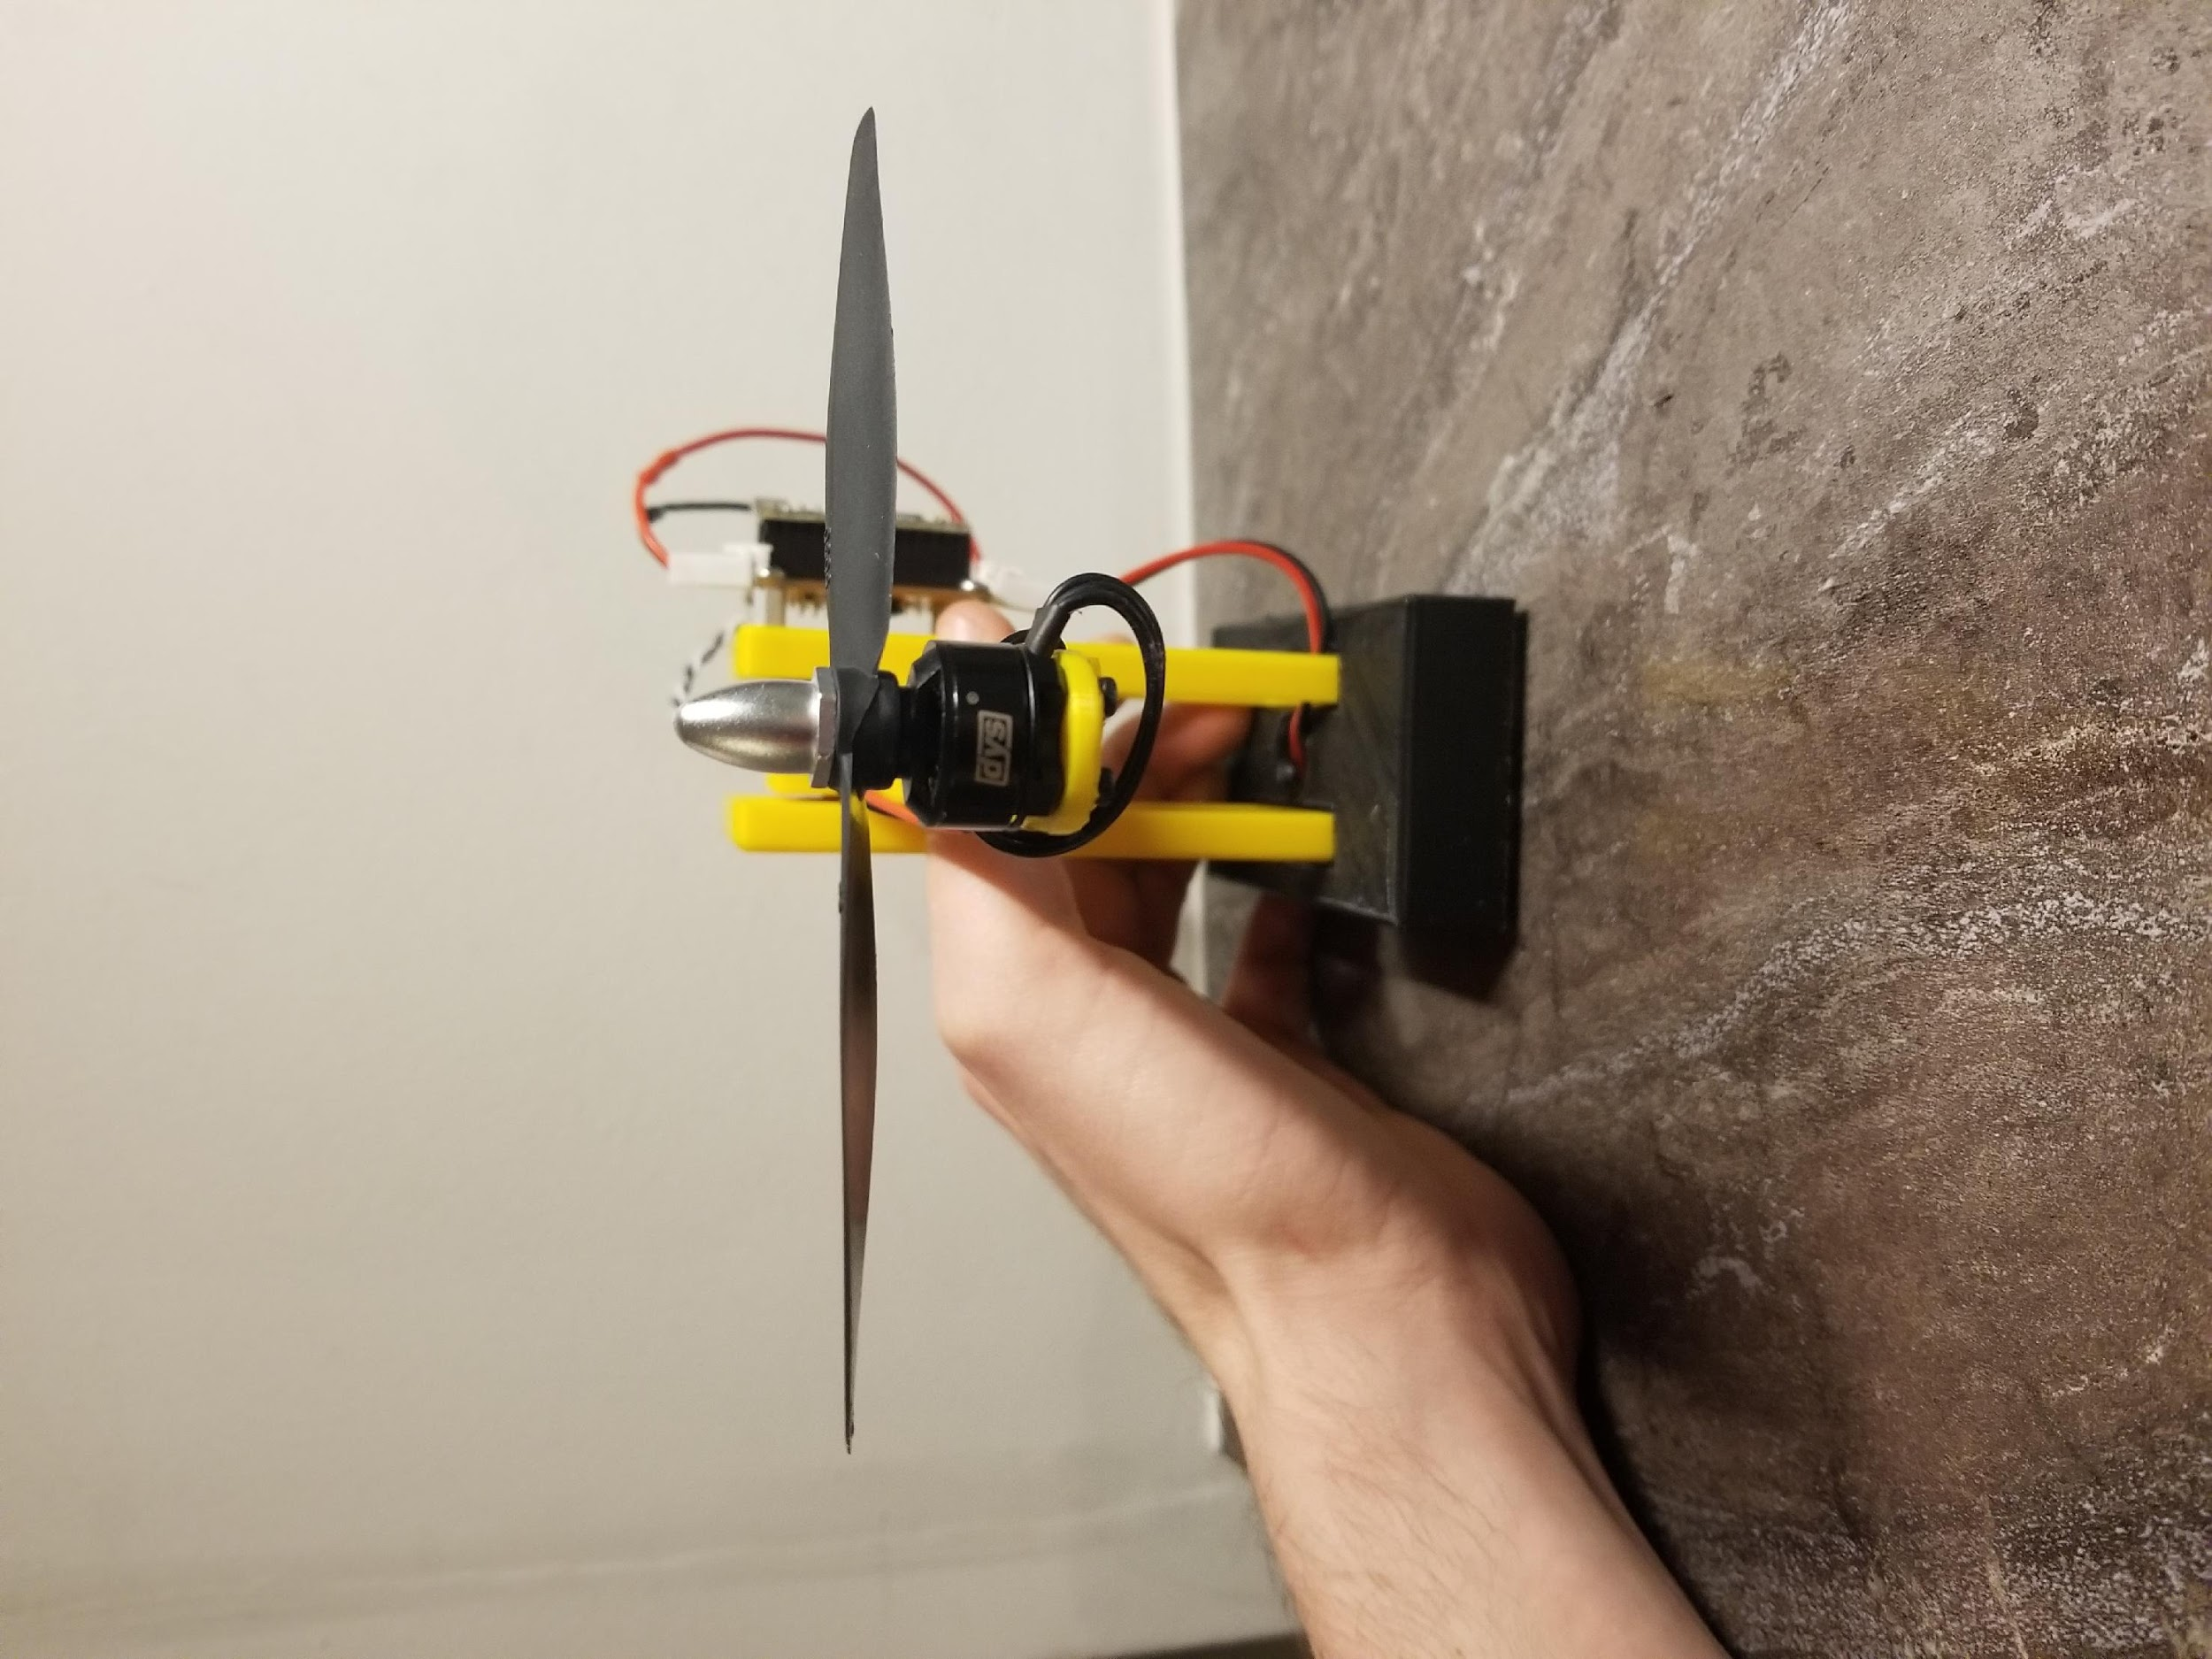
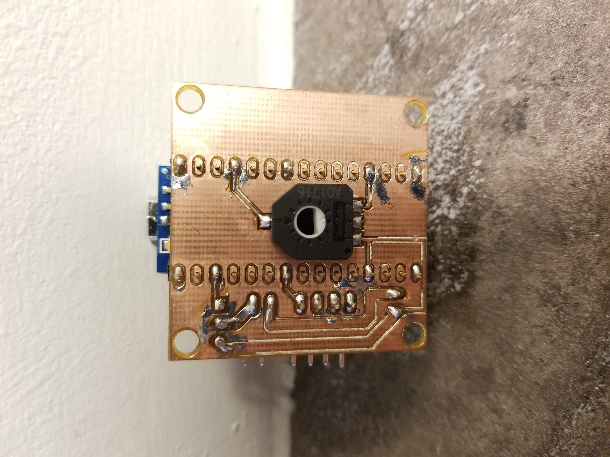
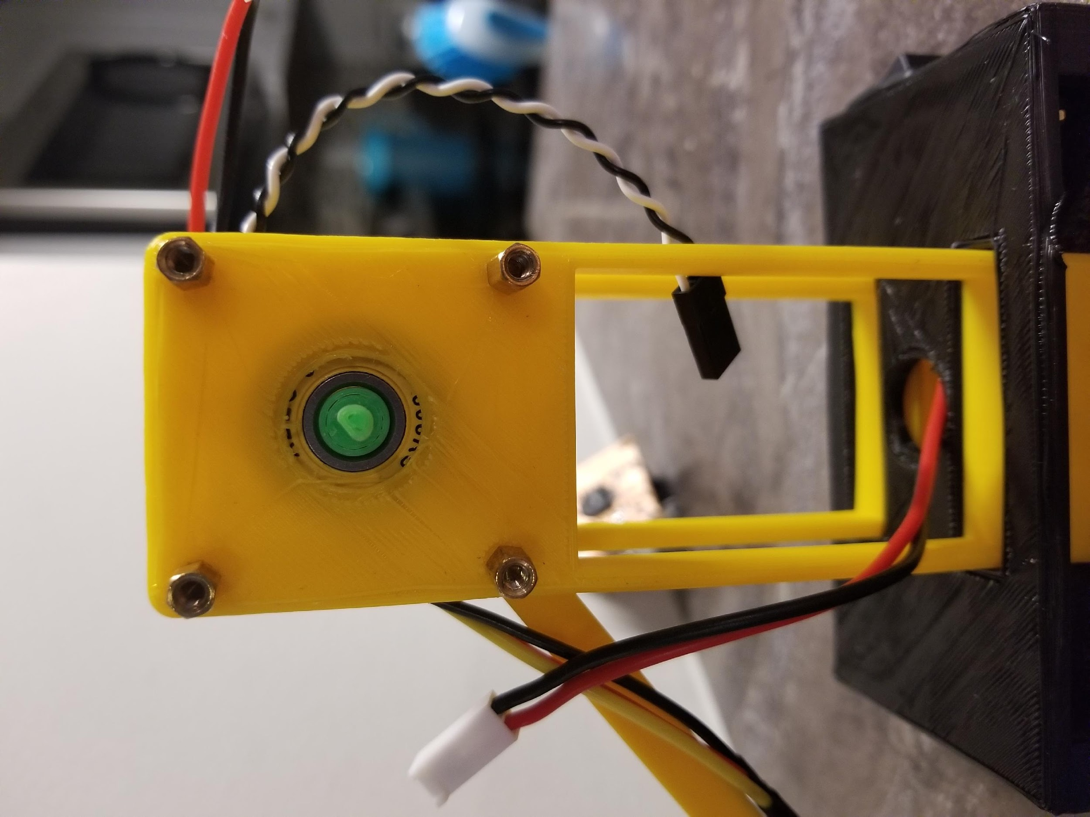
Mechanical Features
Brushless DC Motor
Common amongst RC Hobbyists
Arm on Low-Friction Bearing
Simple & Easy to Model
Rotary Position Sensor
Fixed to Arm Shaft
Notes:
rotary position sensor - measuring the system’s pitch

Slide 5
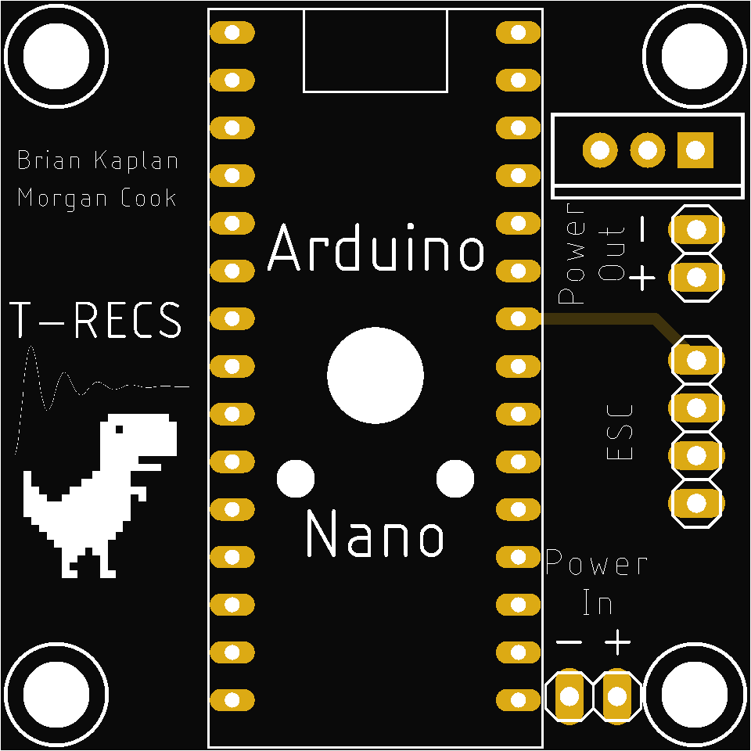
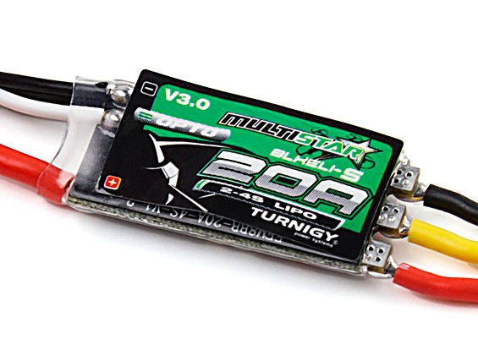
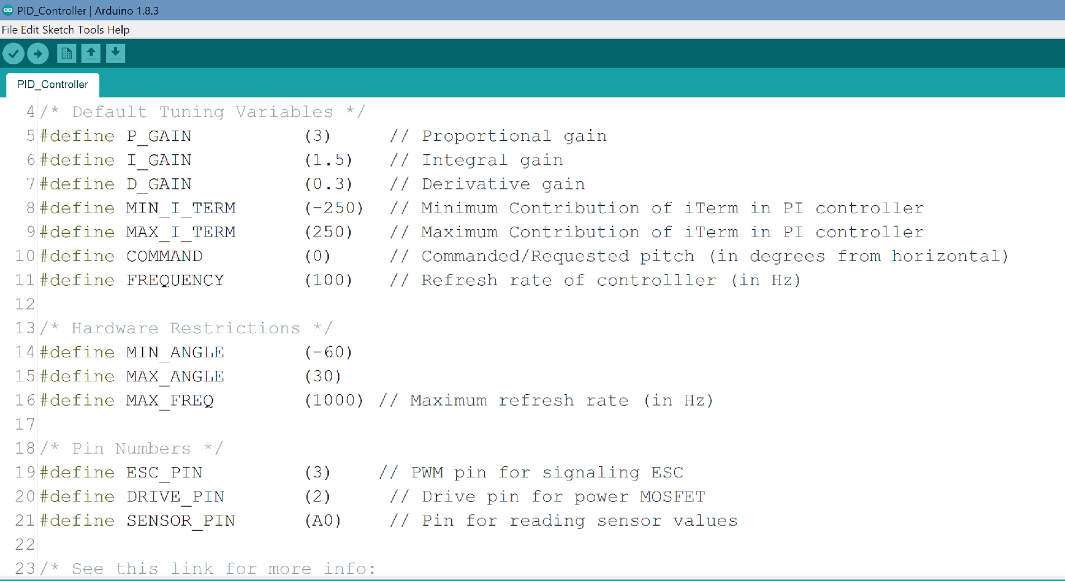
Electrical Features
Electronic Speed Controller
Commonly Found in Quadcopters
Printed Circuit Board
Consolidated Electronics
Arduino Microcontroller & Software
Transparent & Easy to Follow

Slide 6
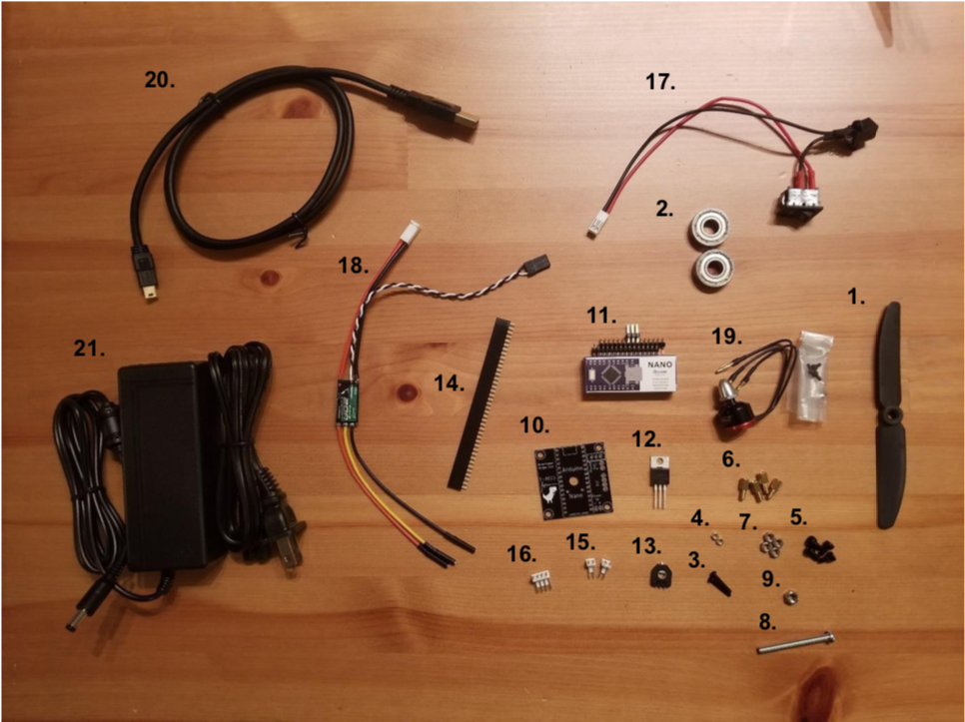
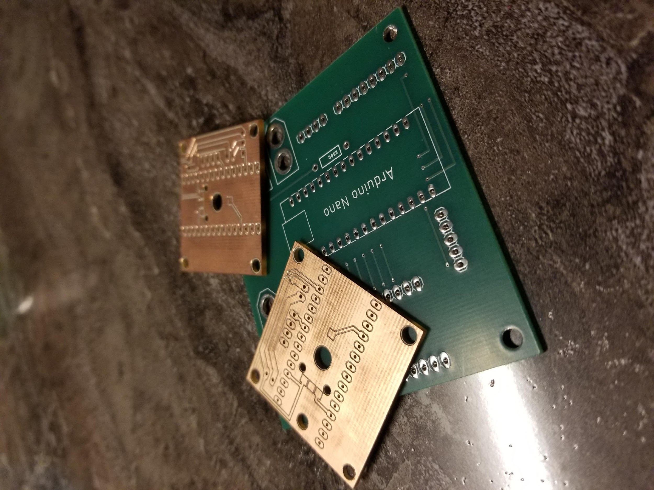
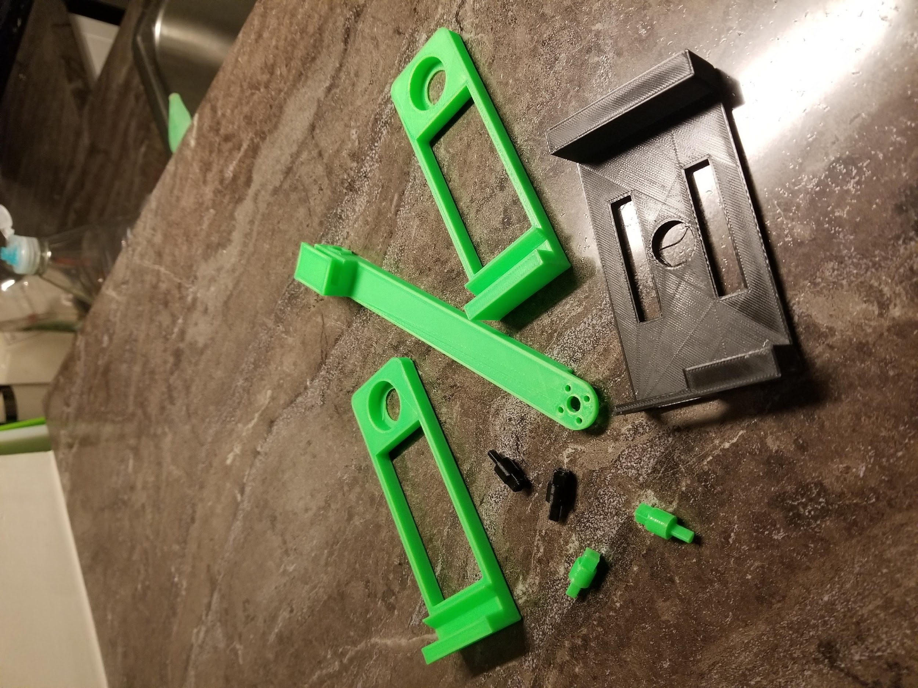
Build your own drone!!!
$50 for a complete product kit
Kit contains
Printed Circuit Board
Electronic Components
Mounting Hardware
Motor & ESC
STL Files
Arduino Code
Notes:
cost is not final yet

Slide 7
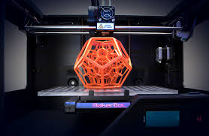


Manufacturing & Assembly
3D printing (6+ hours)
Laser cut on plywood (20 mins max)
Soldering
Software (Arduino)
Notes:
Laser cutting vs. 3D printing TBD

Slide 8
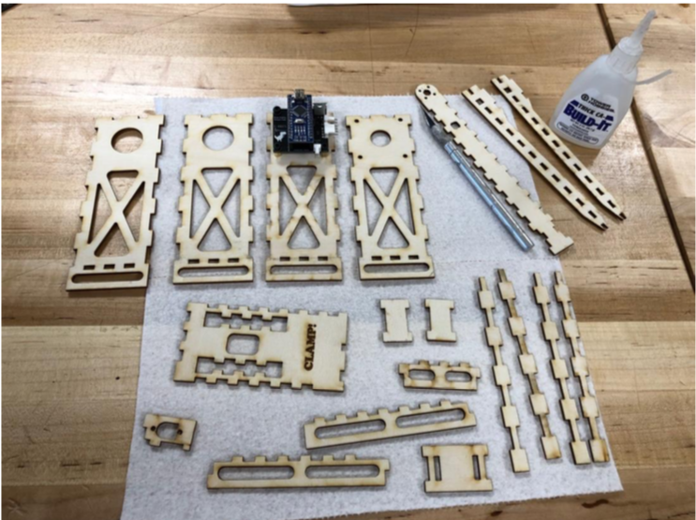
3D print vs Plywood model

Slide 9
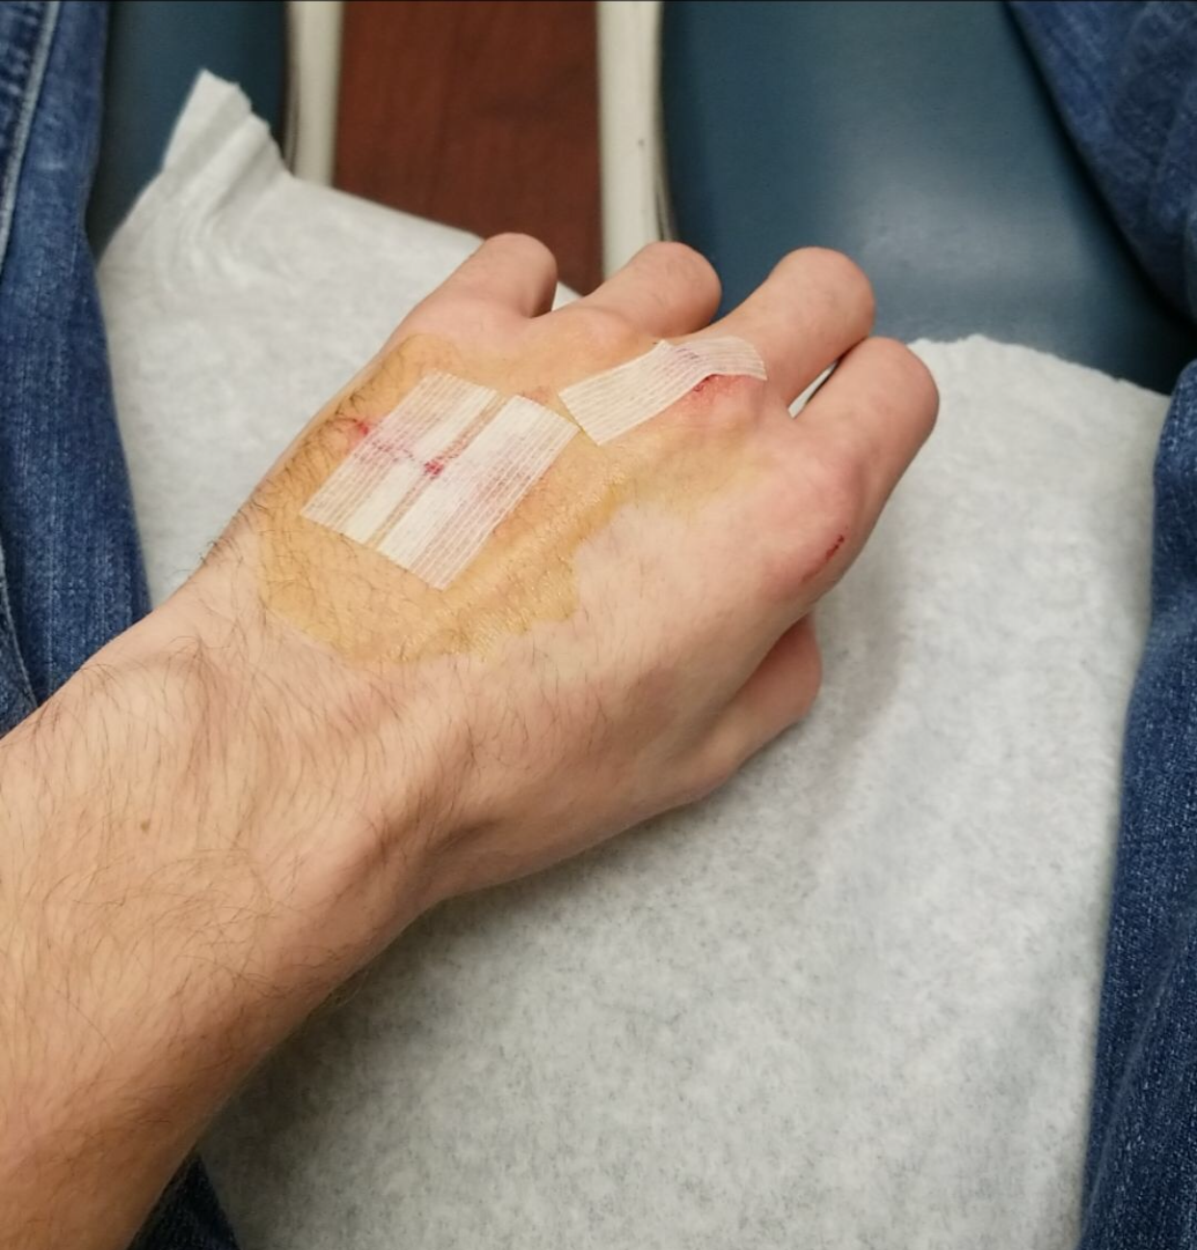
SAFETY
The propeller can spin up to ~20,000 RPM
Can easily penetrate your skin
May require stitches
SECURE YOUR SYSTEM WITH A C-CLAMP
USE YOUR SYSTEM WITH CAUTION!!! PLEASE!!!

Slide 10
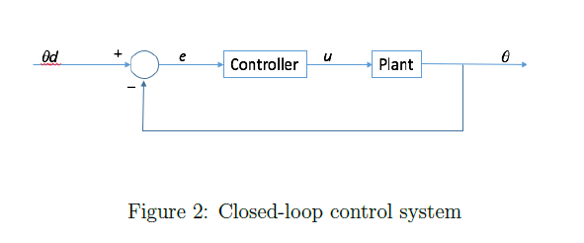
Code Demo

Slide 11
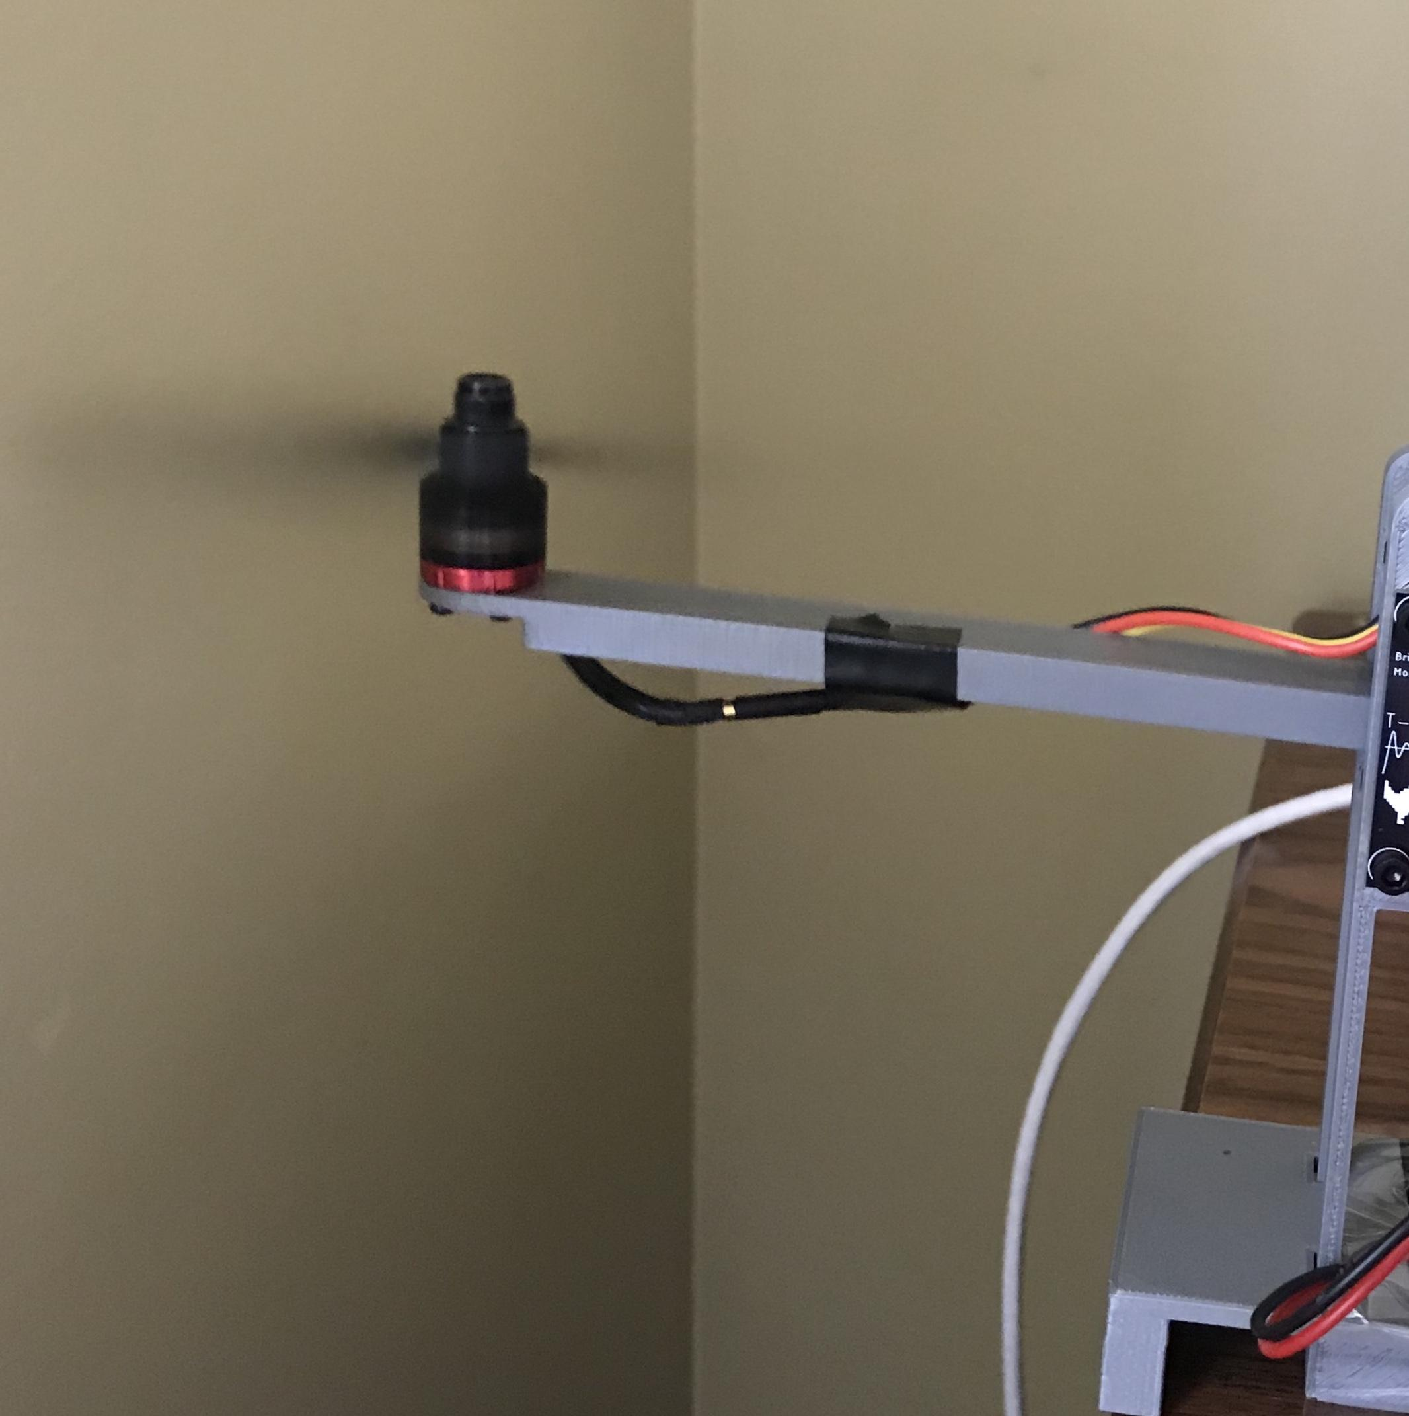
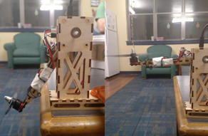
Demo Time

Slide 12

Demo Time

Slide 13
Special thanks to
Morgan Cook and Brian Kaplan
Dr. Feron

Slide 14
In Progress
Optimize the design process
Implement new controller algorithms in accordance with course curriculum

Slide 15
Questions?

